Slide 1
You have one (1) new video message.
From: Felicity Bell, Communication Officer of CIRCLE
Press the link below (hold ctrl key + press the link) to be redirected to the video
and follow the instructions:
“Link”
Invitation: You are more than welcome to share your creations with us
by posting it at the group of CIRCLE in Microsoft Teams.
We are looking forward to it!

Slide 2
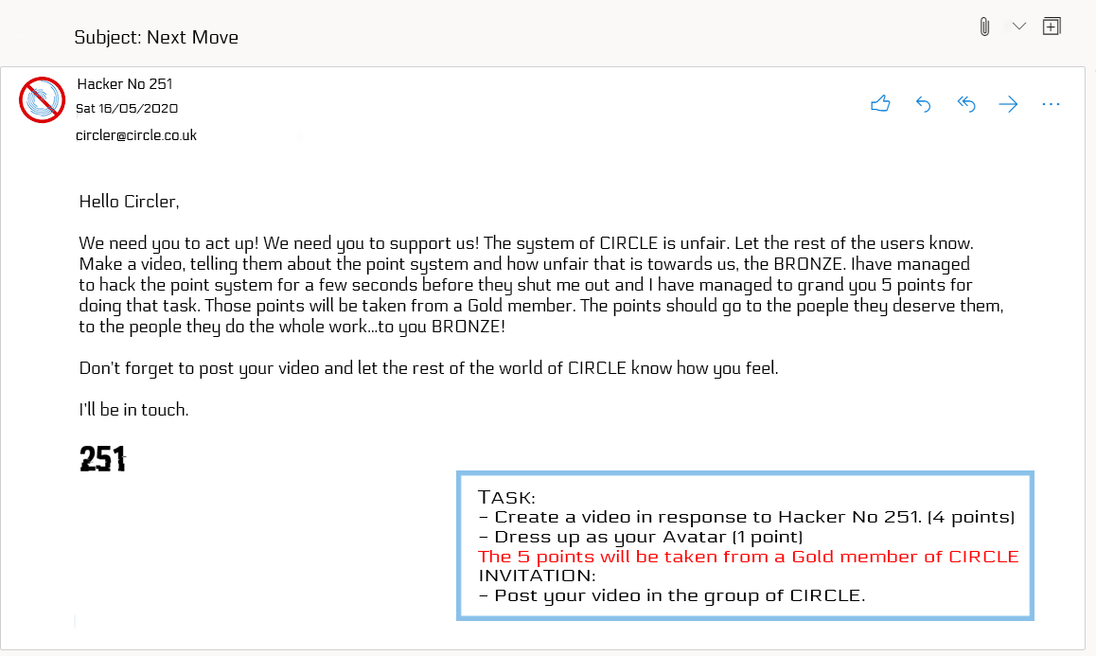
You have one (1) new e-mail

Slide 3
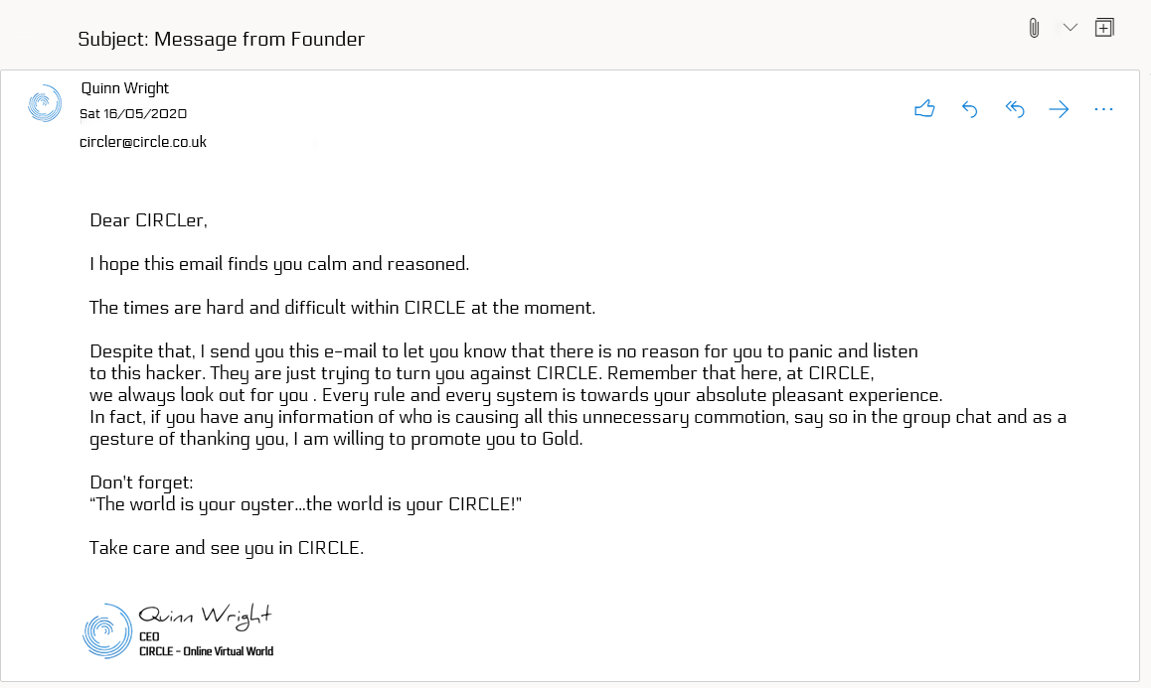
You have one (1) new e-mail

Slide 4
Don’t forget to log out. See you next week!

Slide 5
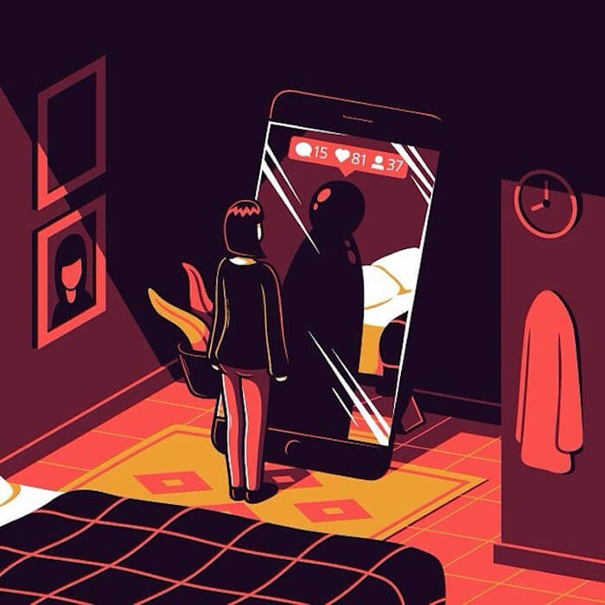
Consider this...
Press the link below (hold ctrl key + press the link) to be redirected to the video:
“Link”

